Slide 1
Reimagining the Consumer Experience:
The Future is Now
Notes:
We are doing great things to meet the immediate needs in a covid world and wanted to think broader about how we can re-design the experience.
How does automation play in the new COVID-19, and how do take an offensive approach in the changing consumer landscape.

Slide 2
Agenda
Introduction to ROC Associates
The Evolution of Retail
What’s Being Said in 2020/2021
What are the Formats Available to Retailers
What Defines an Autonomous Store
Benefits to Retailers
ROC’s Frictionless Journey- Quick Eats
What will Your Frictionless Journey Look Like?

Slide 3
ROC Experience
Strategy
Technology Platforms
Sourcing the Right Tech
Business Process Evaluation
Consumer Experience
Process
Best Practice Development & Implementation
Category Management
Change Management & Training
Technology
Digital Transformation
Store Systems
Inventory Optimization
Workforce Optimization
Customized Development Management
©2022 ROC ASSOCIATES

Slide 4
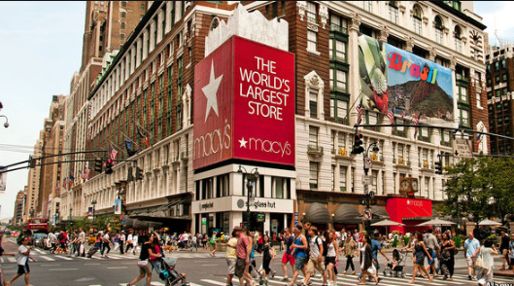
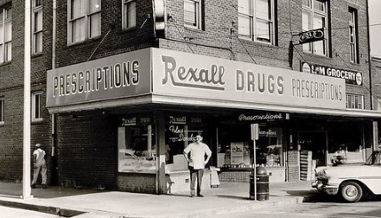
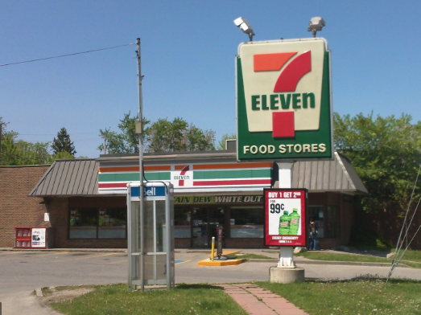
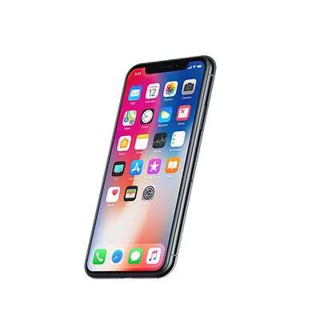
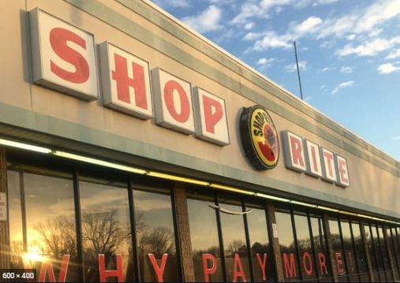
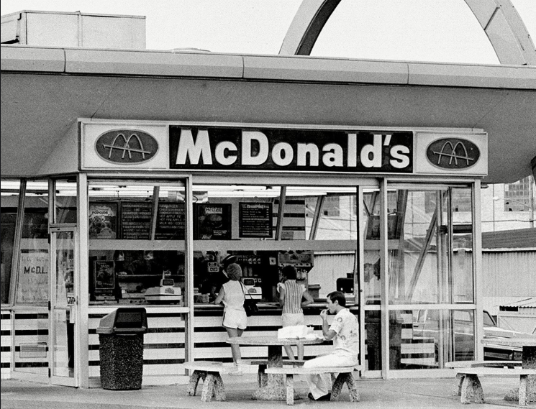
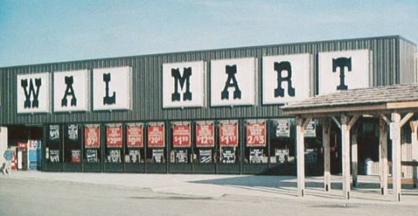
Disruption of Retail
AWARENESS
ARRIVAL
ENTRY
PRODUCT SELECTION
PURCHASE/PAYMENT
PURCHASE
Department Stores
Convenience Stores
Drugstores
E-Commerce
Delivery
The Future Is Now with Frictionless & Automation
1870’s
1930’s
1950’s
1960’s
1970’s
1980’s
1990’s
2000’s
2010’s
Supermarkets
Fast Food
Big Box Retailers
Mobile
Notes:
This is a visual of the retail journey over the years, which took decades.
Now fueled by COVID in 6 months we have seen – Ecommerce Up 129%, Spending on Meal Delivery Up 70%, More than half of Americans are using contactless payment,
More than 1/3 of Executives in a recent survey say they are investing in automation as a direct result of COVID

Slide 5
Notes:
Things continue to grow and change, we are monitoring how automation is impacting the marketplace.

Slide 6
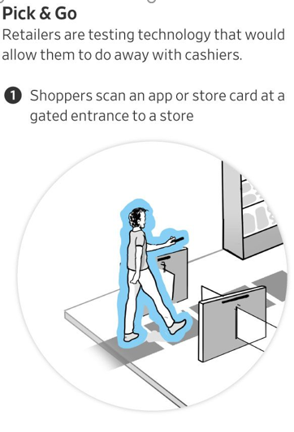
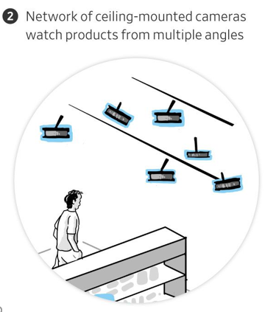
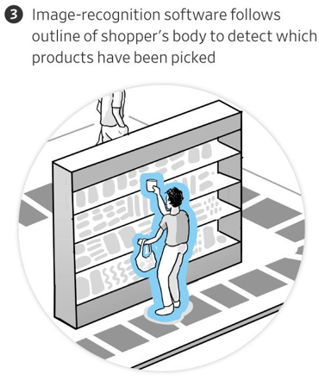
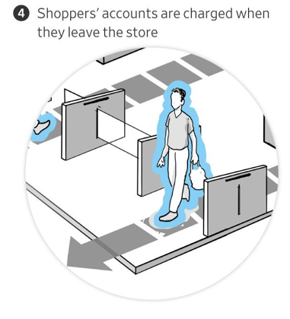
What is Autonomous Checkout
A combination of sensors, cameras, computer vision and deep learning
Cashierless checkout technology that enables the customer to simply shop and walk out
The reimagined consumer checkout experience is targeted towards reducing labor, increasing throughput, reducing lines, reducing touchpoints, automating labor intensive food offerings and redistributing existing labor into improving the consumer experience through brand ambassadorship which creates employee roles that improve recruitment and retention.
Data gathered is consumer behavior centric, actionable and easily monetized and on par with ecommerce
Notes:
Reducing labor is only one part of this. It’s also low touch/no touch and can improve throughput in high transaction locations - saving 1 second per transaction - translates to millions of dollars
Changes your ability to personalize the experience, taylor loyalty in a way that makes it hard for competitors to compete - like Kroger accomplished years ago
The millenial workforce - don’t want to scan cokes/smokes

Slide 7
The Frictionless, Autonomous Experience
Next Gen for the Next Gen
Innovative, data led solution integrating leading edge technology to enable a highly personalized and convenient shopper experience.
Not a One Size Fits All
Fully flexible platform providing brands with ability to customize the experience based on location, merchandise mix, and consumer journey.
Plug and Play
Low cost and light touch ‘out of the box’ solution designed to minimize level of operational and technology lift needed to launch initial pilot.
Built for Scale
Applies commercial focus from design in order to develop experience that can prove revenue growth and store operational efficiency
1/30/2020
3

Slide 8
Promising Benefits to Retailers and Shoppers
Why all the interest in “checkout free”?
Eliminates the biggest customer pain point - checkout wait times
Provides incremental revenue streams via new locations where you don’t operate today (i.e.) Urban centers without fuel
Redistributes labor that is now purely focused on an improved consumer experience – brand ambassador
Creates a destination shopping experience
Increased transaction throughput
Reduced shrink (internal and external)
Personalized loyalty and promotions in real time via the app and shelf edge technology
Allows for 24/7 opening hours in a climate of labor shortages
Insights regarding consumer shopping behavior is a game changer and can be commoditized
The data begins at check-in (app or credit card) and continues through the entire store journey
Generic demographics such as
Male/Female
Age bracket
Smiling upon entry
Traffic patterns
Dwell times
Reach and Put back
Notes:
Grudge purchase in terms of fuel so making the remainder of the experience low friction is important
Revenue is missed due to pay at the pump so incremental sales are critical to capture

Slide 9
Hurdles to Autonomous checkout
Solution cost
Customer data privacy and growing regulations
Operational scalability for chain wide deployment (placement of shelf sensors & cameras) feasibility to replace or retrofit existing shelving w/ sensors
The retail experience is changing quickly, driven by consumers ongoing redefinition of the retail experience durin/post COVID - still TBD
Merchandising flexibility challenges (displays/endcaps). This isn’t a simple reset anymore
Insightful analytics are constrained through the lens of privacy

Slide 10
Autonomous Checkout - Things to Consider
Operational considerations
Product training adds to complexity and time to introduce new products as well as seasonal packaging changes (e.g. Santa Claus Coke)
If fully autonomous, how and when to deploy the needed labor (i.e.) cleaning, spills, vendor deliveries, customer complaints
Technical Considerations - Depending on Format
Camera-only Solutions while less complex and costly, are less accurate than cameras in combination with shelf sensors
Ceiling height- Some providers have minimum height requirements
Store side servers or edge technology
Internet bandwidth can be as much as 10+ Mbps
Consumer Experience/Journey
The need to "train" customers on how to engage in this new environment - 78% of customers feel like they are stealing or don’t understand how to navigate the experience and may choose to avoid it.
Location and Type
A frictionless store within a store is operationally challenging except for very specific use cases or store formats
Fully converting existing stores is still a cost/benefit analysis which may impact product mix due to technology limitations
Option of adding a frictionless element that is outside the existing store
Creating a new format through a new build design that facilitates this technology now or in the future
Create a completely new business vertical by extending your brand in new locations and a new footprint (i.e.) Urban, Suburban, Fuel, Non Fuel, (i.e.) Within residential buildings, office buildings, gymnasiums
Convenience where you live, work and play .
Pop Up/Mobile locations for events such as concerts, local fairs, football games, parades
Notes:
Time to train products and approach
The approach varies among providers so understanding your end game is critical
Consumer training without confusion with your existing business
Type of location must be predetermined. The goal should not be to compete with Amazon Go

Slide 11
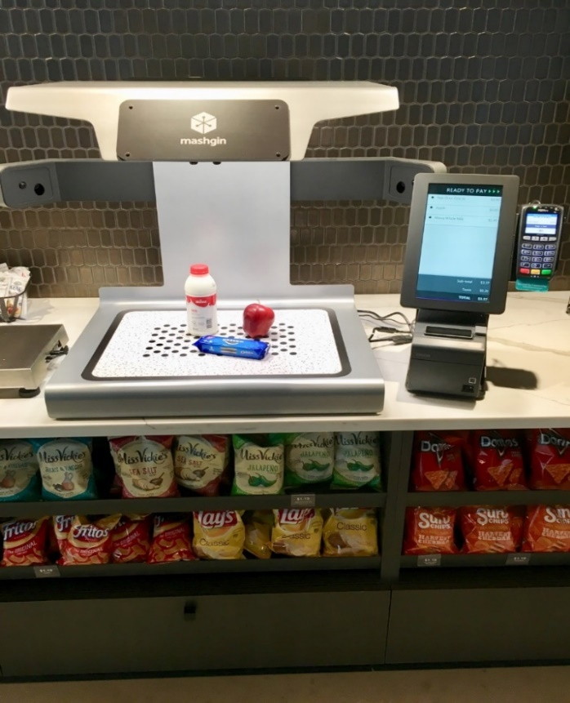
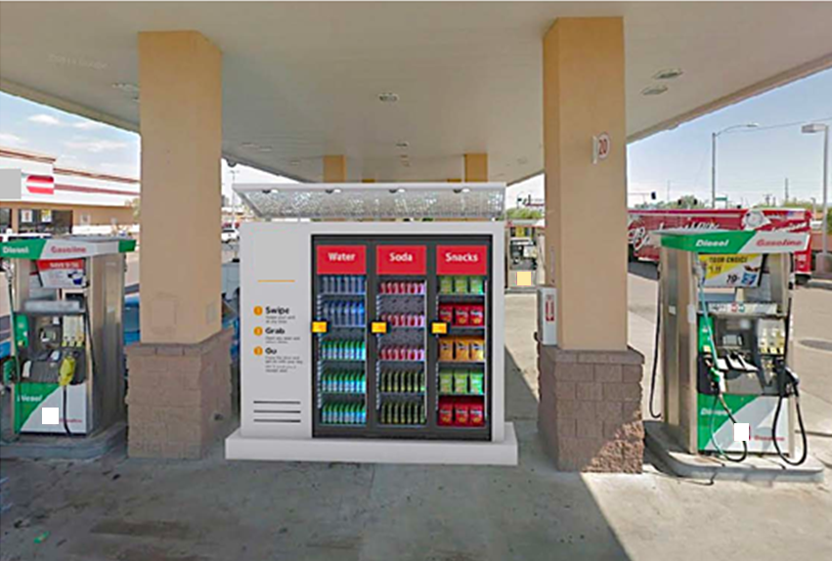
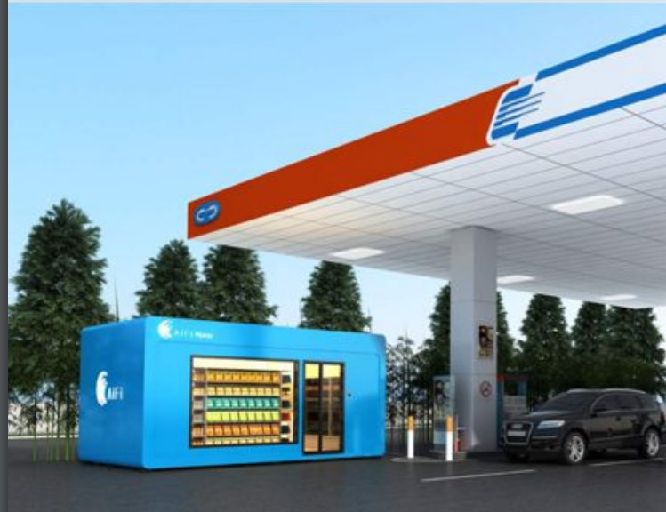
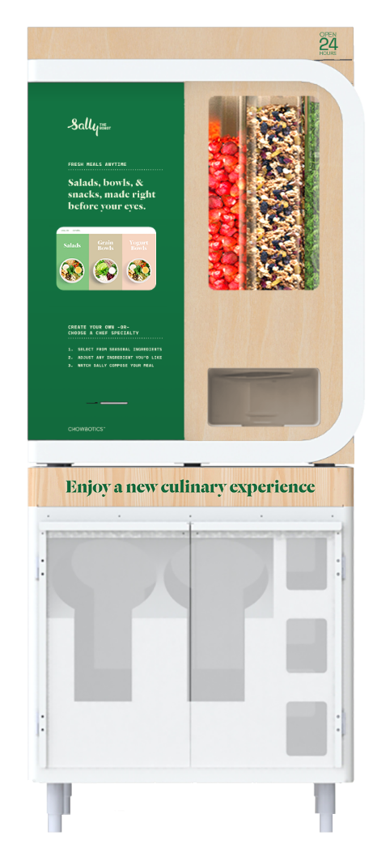
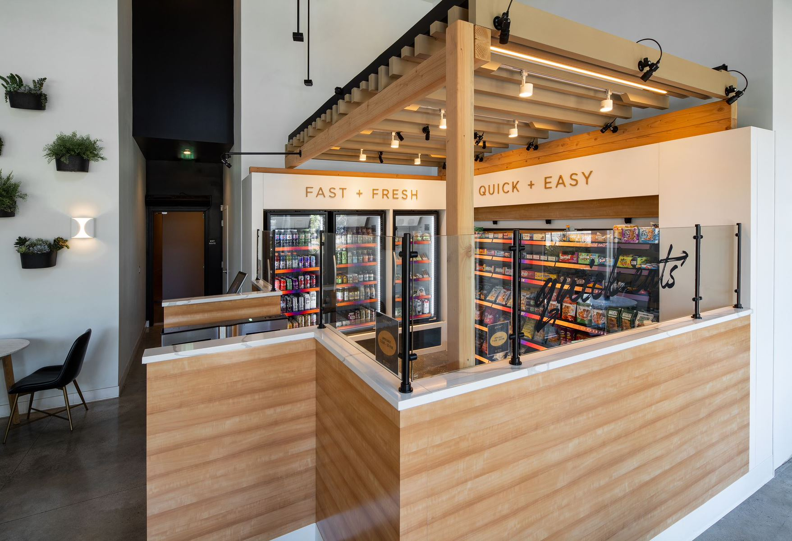
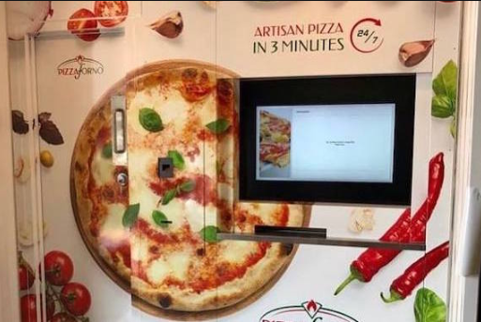
Designed to be Deployed a Variety of Formats
Self Checkout
Walk Up
Modular Walk In
increased basket size from personalized offers
Robotics
Walk In
Robotics
Notes:
Frictionless, low touch/no touch can mean many things to many people and comes in a variety of formats - it’s important to define your end game before evaluating what is available

Slide 12
ROC’s Frictionless Journey with Aramark
Notes:
We are doing great things to meet the immediate needs in a covid world and wanted to think broader about how we can re-design the experience.
How does automation play in the new COVID-19, and how do take an offensive approach in the changing consumer landscape.

Slide 13
Notes:
Why is this applicable
ROC wants to take you through the story of how in 8 short months a fully autonomous store was opened in the middle of a pandemic no less.

Slide 14
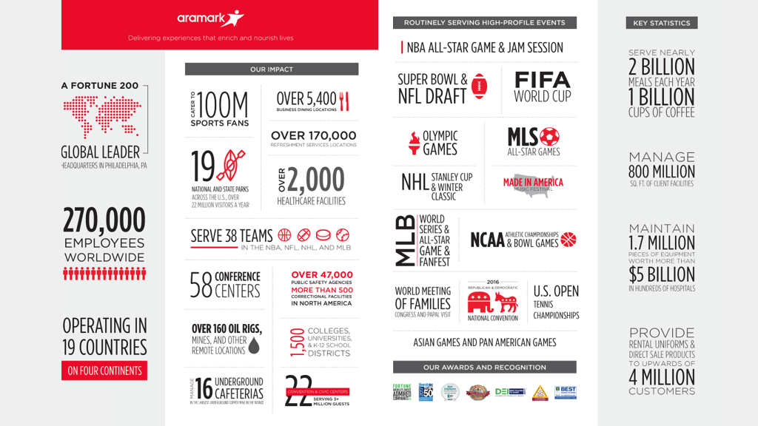
Notes:
7 out of 10 Americans touch them multiple times a day

Slide 15
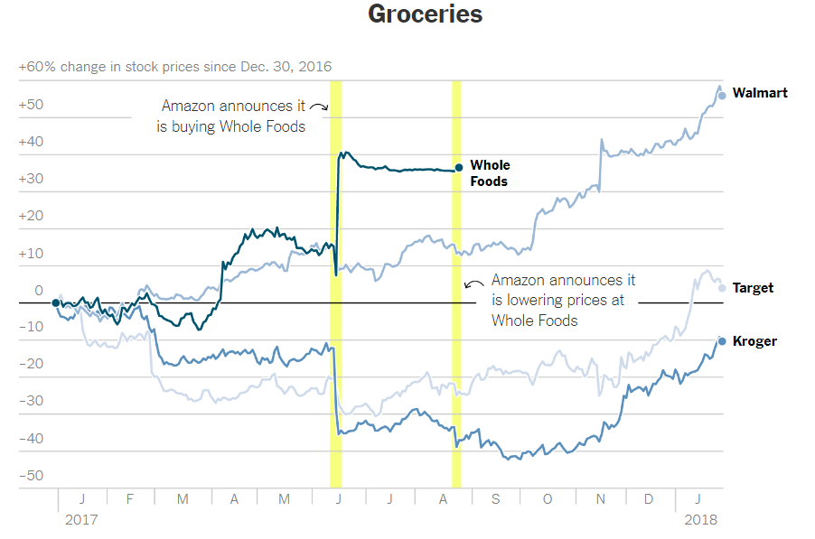
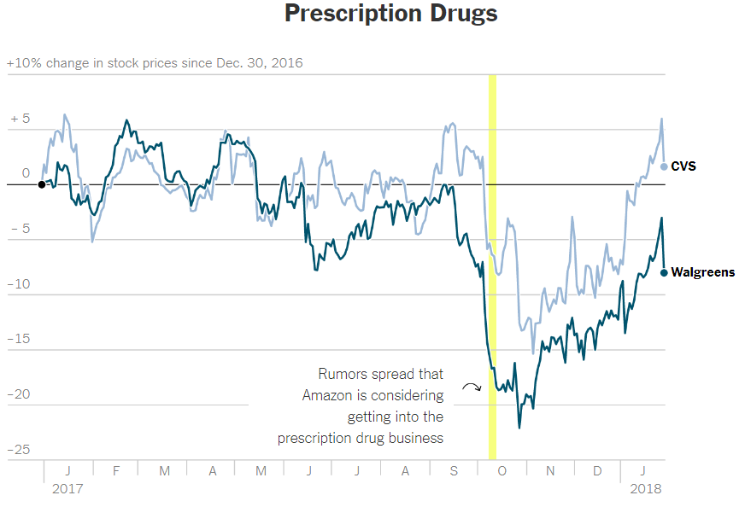
Amazon’s Ability to Disrupt
Notes:
When Amazon expresses an interest in an industry, the impact is immediate as seen here - they have yet to enter this space
For a Fortune 200 company like Aramark the threat of disrupting their core business was enough to mobilize them - not to compete but to disrupt and reinvent their image to shareholders

Slide 16
Quick Eats - Results Driven
Labor reduction from 40% to 4%
TAM increase – $25B opportunity (avg)
Check out time reduced from 63 seconds on average to 0 seconds [NACS fact sheet].
Scan-based Trading
30% reduction in excess inventory
50% reduction of out of stocks
Increase on RoA by 4%
Data Monetization (TBD)
Digital ad revenue – CPM tbd
Consumer behavior monetization – sell to vendor tbd

Slide 17
Project Charter and Cadence
Mission Statement - Close Convenience Where you Live Work and Play
There are no crazy ideas. In fact we want crazy ideas
Fail Fast and Fix Fast - Ideate and Iterate
Quick Eats Team: “Self-disruptive paradigms cannot survive legacy frameworks.”
Take a technology-first approach to solving any challenge until we have exhausted all options
Finally and Most Importantly was the message from the C-Level Executives:
“Don’t let us get in your way”

Slide 18
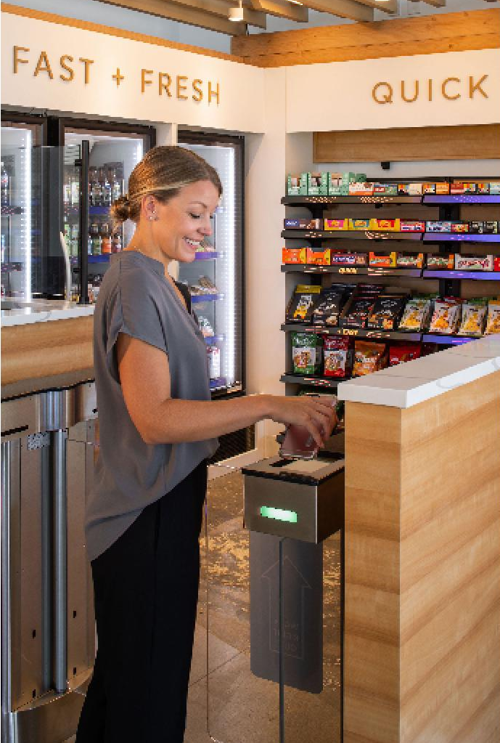
Consumer Experience
Quick Eats - Close Convenience™

Slide 19
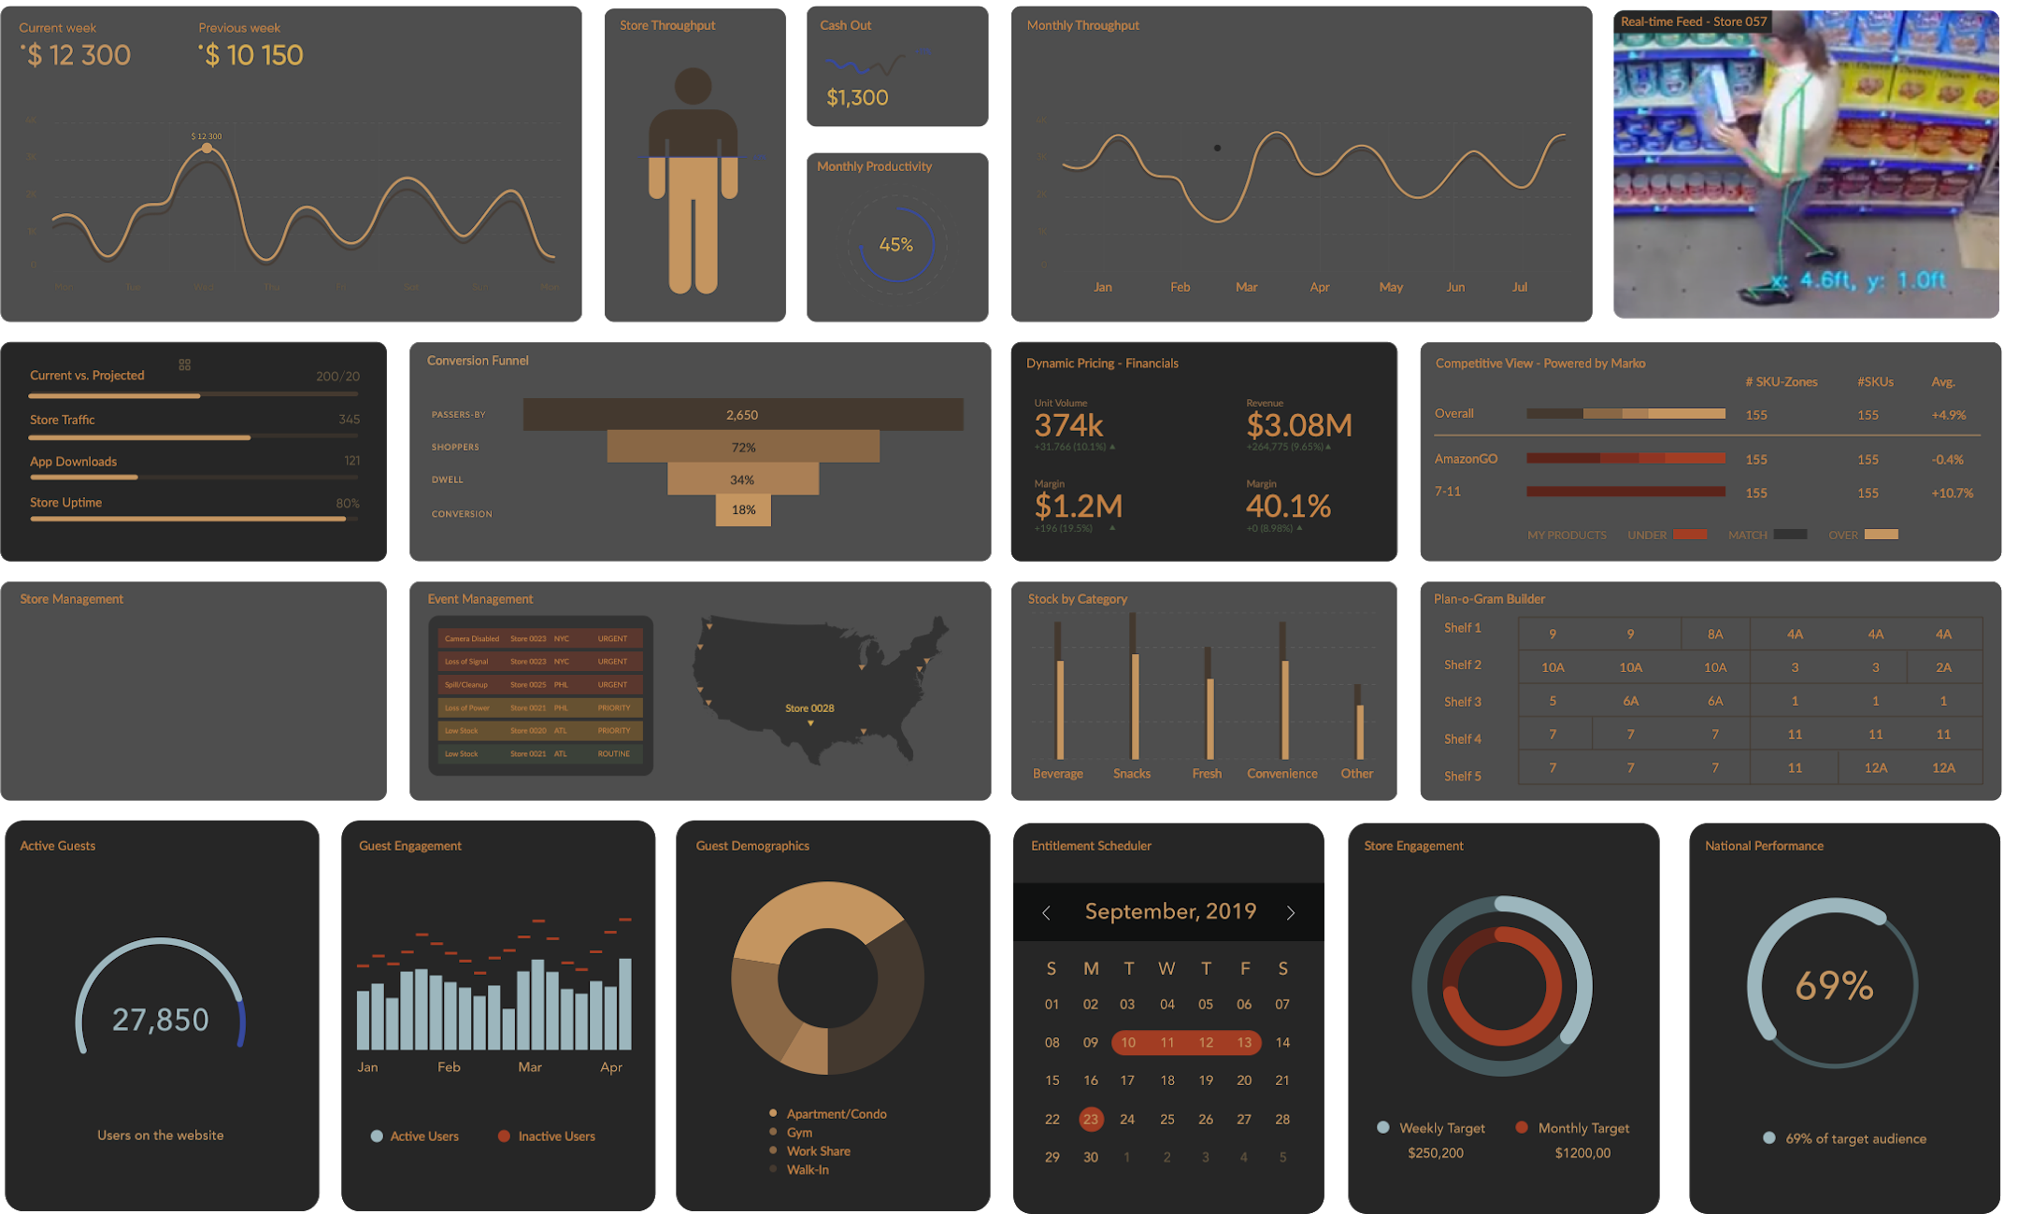
Notes:
Example Dashboard that will allow for the remote management of stores, send real-time in-store alerts and updates, and provide real time actionable metrics
Monitor week over week, and projected vs. actual targets in real time
Store event alerts centralized to one location, allowing for actions to be taken remotely for the store – Example: Cooler temperature above threshold, or light burned out
Real time view of planogram compliance, and product inventory levels
Dynamic pricing and margin data at your fingertips
Scan Based Training – Pay for product as it’s sold instead of paying during the receiving process
Order to shelf methodology
Computer vision to drive efficiency
Automated back of house – QuickOS

Slide 20
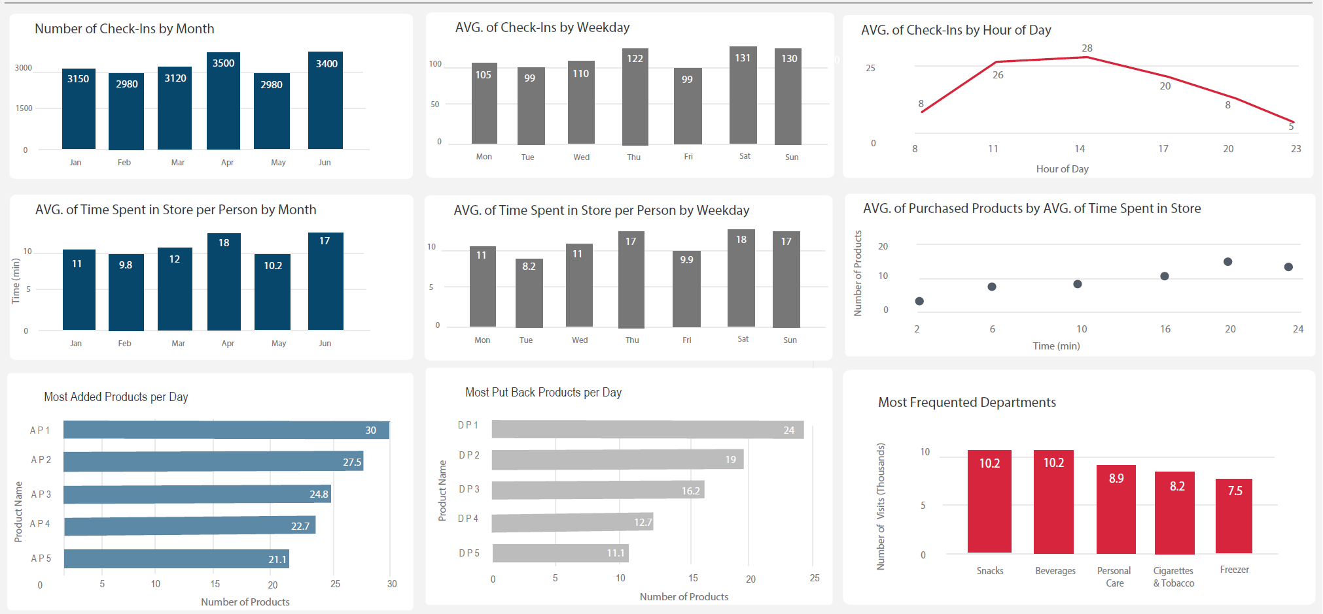
In-Store Behavioral Tracking – Example Dashboard
In addition to sales boost claims, tracking of in-store behavioral data puts in store on par with online

Slide 21
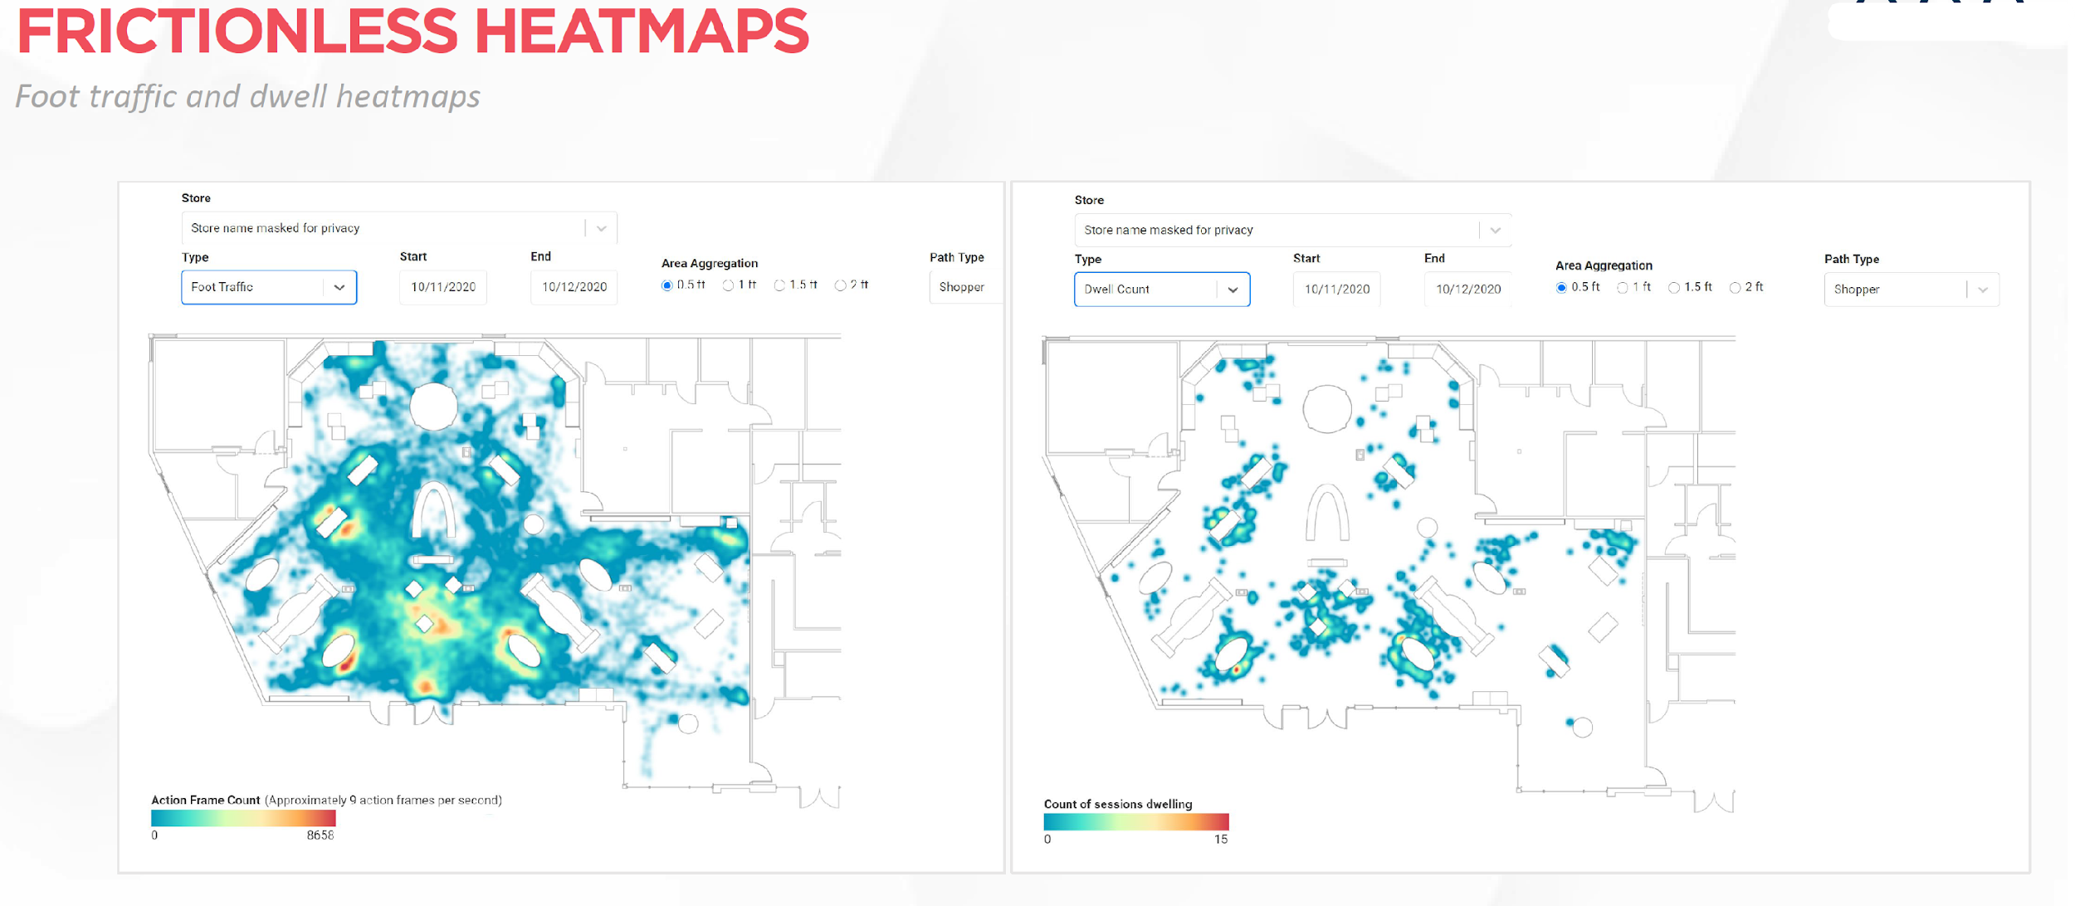
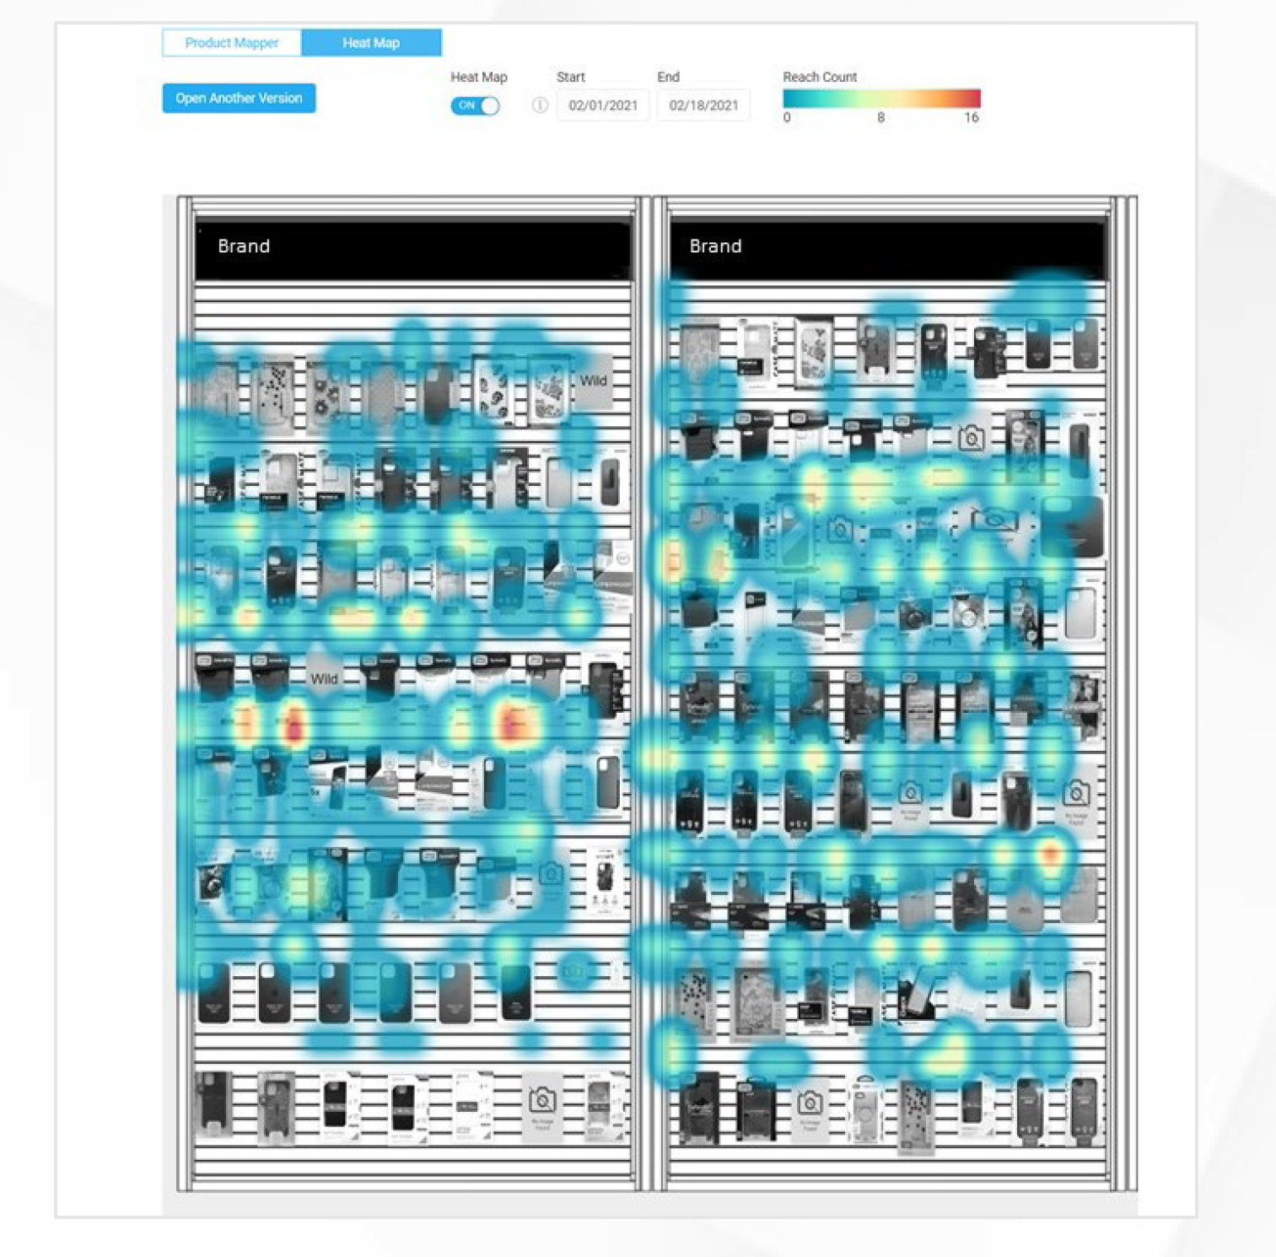
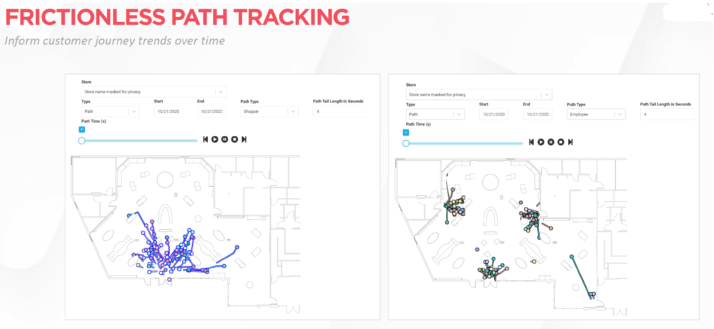
In-Store Behavioral Tracking - Heatmaps & Path Tracking

Slide 22
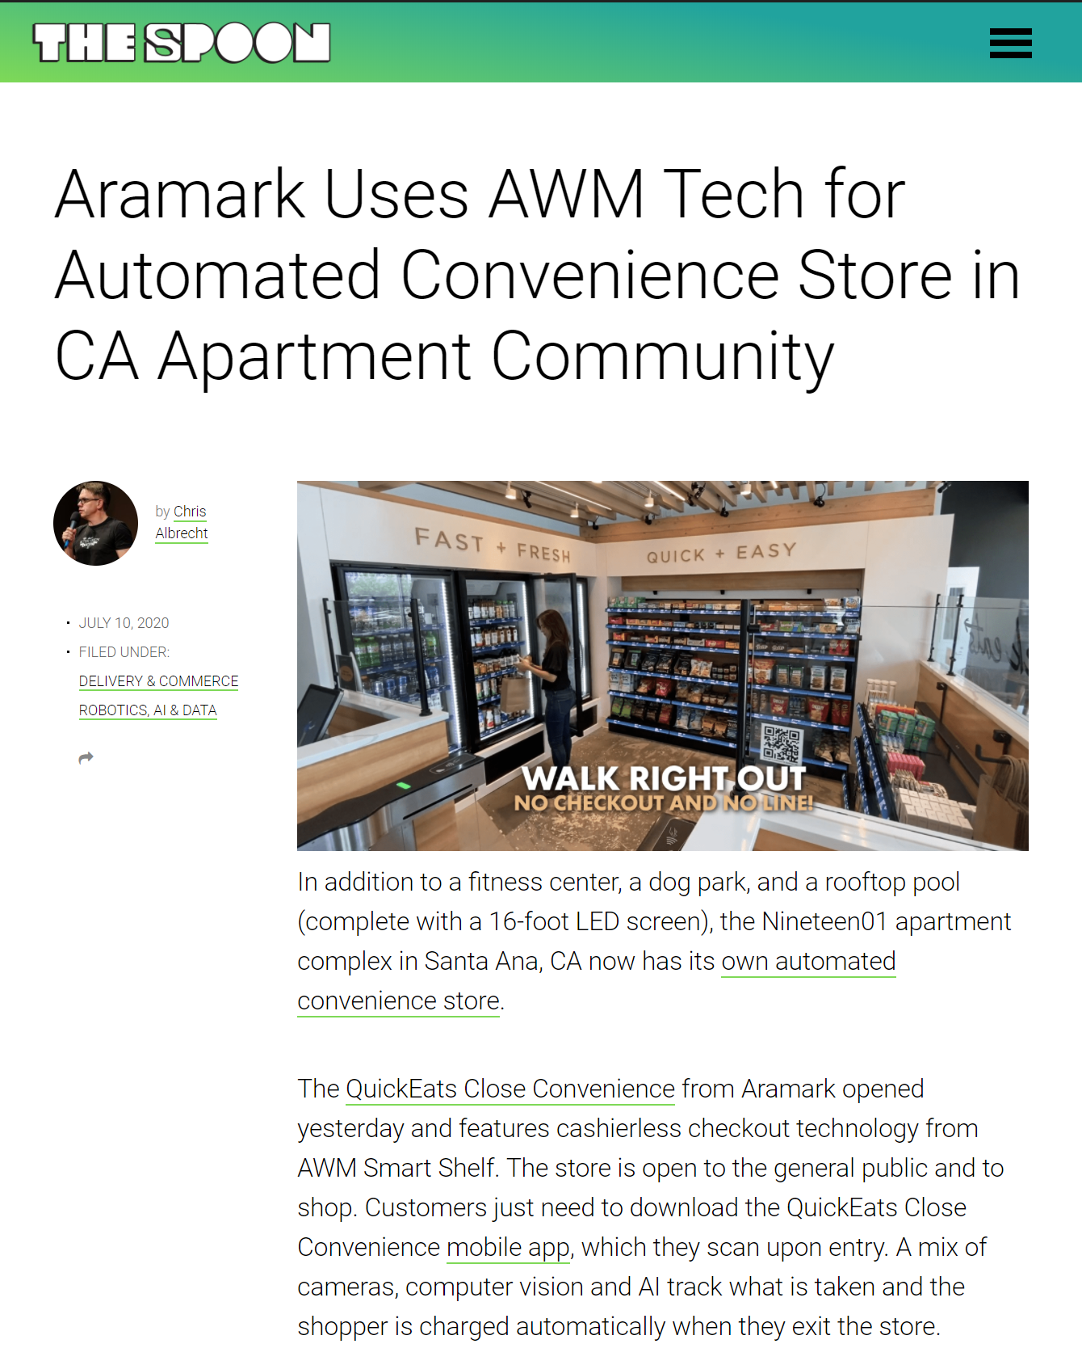
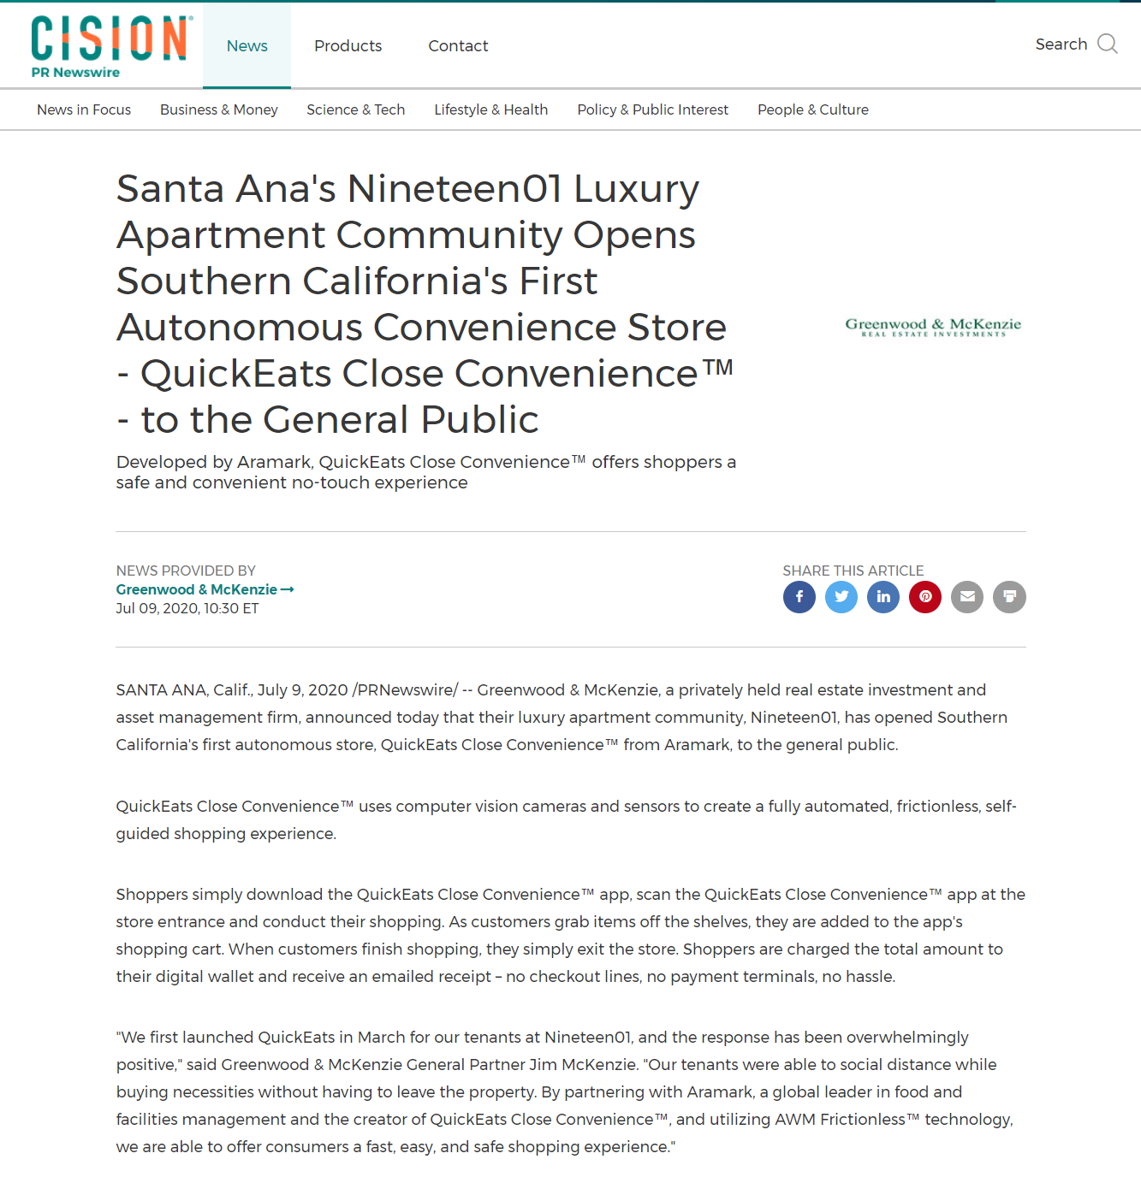
QuickEats In the News

Slide 23
Accolades for QuickEats
Best Convenience Retail Concept
QuickEats Close Convenience, Aramark
QuickEats Close Convenience is a fully automated retail outlet that uses computer vision cameras and sensors to create a fully automated, frictionless, self-guided shopping experience, allowing shoppers who have downloaded and registered on the QuickEats app to browse and handle the offerings, then pay only for what they take. The concept was introduced earlier this year at a California apartment complex.

Slide 24
The Future is NOW – Final Thoughts
The Future is Now
Change by Design not by Default
COVID has Accelerated and Compounded Existing Workforce Challenges
Shortage and Cost of Labor
The Millennial workforce wants a different work environment/experience
The new Gig Economy is thriving
We have to reimagine not just the consumer experience but also the employee experience in order to recruit and retain talent.
Increasing minimum wage will alleviate the situation in the short term but isn’t sustainable
COVID has Accelerated Interest and Deployment of Low Touch/No Touch Automated Technologies
Technology providers are having to accelerate their innovation
The year of the start up is coming to an end with larger tech companies entering the space with a vested interest in protecting their brand name and winning the footrace after a late start. The landscape changes weekly
ROC Associates can Educate and Expedite your Innovation Strategy
Fiona.Harris@ROCAssociates.com
Ph 678-576-2933
1 HOUR Free Consultation

Slide 25
Thank You
Questions??
Notes:
We are doing great things to meet the immediate needs in a covid world and wanted to think broader about how we can re-design the experience.
How does automation play in the new COVID-19, and how do take an offensive approach in the changing consumer landscape.

